Slide 1
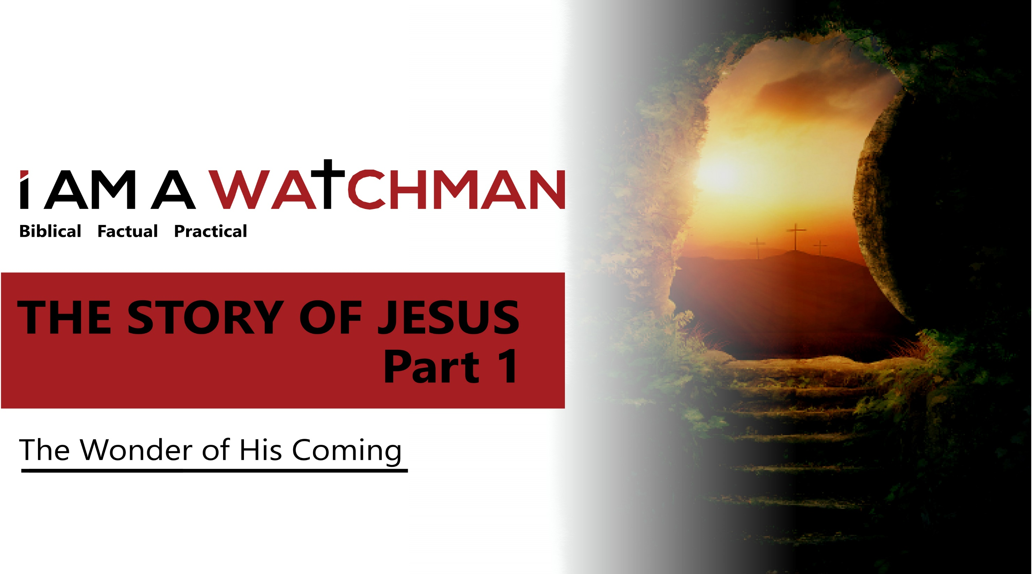

Slide 2
THE GOSPEL WRITERS
Matthew
Matthew was the second Gospel written.
Matthew was known as Levi.
Matthew was a tax collector.
Matthew immediately invited his friends and associates to a special gathering so they could meet Jesus.
Tradition holds that Matthew died by the sword during the reign of the evil Emperor Domitian.

Slide 3
THE GOSPEL WRITERS
Mark
Mark was the first Gospel to be written.
Mark was not one of the 12 Disciples.
Mark was a relative of Barnabas and scribe to Peter.
The Gospel was written in Rome, to a Gentile audience.
Tradition notes that Mark founded a church at Alexandria and died by being pulled apart by horses for his opposition to pagan beliefs.

Slide 4
THE GOSPEL WRITERS
Luke
  Luke was a physician.
  Luke also wrote the book of Acts.
  Writes in Chronological order, and spent some time with Paul on his missionary journeys.
  Tradition notes that Luke was crucified.

Slide 5
THE GOSPEL WRITERS
John
  John was the last of the Gospel writers.
  John also wrote 1 John, 2 John, 3 John and Revelation.
  John wrote with a limited vocabulary.
  The focus of John’s writing is to affirm the deity of Christ. In Hebrew culture the number 7 is associated with God. In John’s Gospel there are…
- 7 miracles attributed to Jesus.
- 7 deity references attributed to Jesus.
- 7 “I Am” statements made by Jesus.

Slide 6
THE NATURE OF JESUS
The coming of the Messiah is the fulfillment of prophecy
There are 456 Messianic references in the Old Testament and more than 500 in the Talmud.
There are more than 125 distinct Messianic Prophecies (more than 300 combined or general prophecies).
The odds of just 20 Messianic prophecies coming true is 1 in 100 million.
The odds of just 31 of the Messianic prophecies coming true is 1 in 2,540,000,000,000,000,000,000,000,000,000.
Notes:
The odds of 55 Messianic prophecies coming true is approximately 1 in 10^{157th} power

Slide 7
THE NATURE OF JESUS
John 1:1-5
Jesus has an eternal nature. “In the beginning was the Word…”
Jesus is one with God.
“…The Word was with God and the Word was God.”
Jesus is the Word, God, Creator, Light, Life, the Father’s only Son, and full of grace and truth.

Slide 8
THE GENEALOGY (MATT. 1)
The variety of individuals listed indicates…
- That God can use anyone, and desires to use everyone to accomplish His purpose.
The structure of Matthew’s narrative indicates…
That God works wonderfully and perfectly through the ages. - There are 3 sets of 7 generations separating key points in Hebrew history.
Notes:
The numbers 3 and 7 have spiritual significance in Hebrew culture (both are linked to the divine).

Slide 9
THE GENEALOGY (MATT. 1)
Jeconiah was the second to the last king of Judah.
He was very evil and reigned only 3 months.
He was cursed by God through the prophet Jeremiah (Jer. 22:24-30) and told that none of his descendants would prosper on the throne.
The Holy Spirit’s union with Mary breaks the curse and makes it possible for Joseph to be a father to Jesus.
The mention of Jeconiah indicates…
That God can make a way

Slide 10
THE BIRTH OF JOHN
The miracle
Zachariah and Elizabeth had asked the Lord for a child for many years. At this time Elizabeth was considered past the age of being able to conceive.
The fulfillment of prophecy
Isaiah 40:3-5 (“The voice in the wilderness”)
Malachi 3:1 (“God will send a messenger to prepare the way [for the Messiah]…”)
Notes:
See Malachi 4:5-6 and Matthew 11:7-15. John fulfilled prophecies by being the forerunner of the Christ—preparing the way for His ministry by preaching the need for repentance and baptizing in the Jordan River for approximately six months prior to the baptism of Jesus.

Slide 11
THE BIRTH OF JOHN
The consequences for lack of faith
“When Zechariah saw [the angel] he…was gripped with fear…the angel said to him: ‘Do not be afraid…Your wife Elizabeth will bear you a son, and you are to give him the name John.’ Zechariah asked the angel, ‘How can I be sure of this? I am an old man and my wife is well along in years.’ The angel answered, ‘I am Gabriel. I stand in the presence of God, and I have been sent to speak to you…And now you will be silent… until the day this happens, because you did not believe my words, which will come true at their proper time.’” (Luke 1:12, 18-20)

Slide 12
THE BIRTH OF JOHN
God’s grace and the restoration of Zechariah
Luke 1:57-79 notes that Zechariah was restored and blessed.
- His voice was restored.
- His position of honor in the Temple was restored.
- He was given a prophetic message.
Notes:
Luke 1:59-64 “On the eighth day they came to circumcise the child, and they were going to name him after his father Zechariah, but his mother spoke up and said, ‘No! He is to be called John…’ Then they made signs to his father, to find out what he would like to name the child. He asked for a writing tablet, and wrote…’His name is John.’ Immediately his mouth was opened and his tongue was loosed, and he began to speak, praising God.”
Luke 1:67 “…Zechariah was filled with the Holy Spirit and prophesied…”

Slide 13
GABRIEL’S ANNOUNCEMENT
The birth of Jesus was the fulfillment of prophecy, and announced by Gabriel
Gabriel is an archangel—one of two named in Scripture.
Mary: Her genealogy in Luke presents her as having a notable bloodline, but she was poor and from Nazareth—reason enough for the religious elite in her day to disqualify her from having any role regarding the coming Messiah. However, God was not considering her degrees, accomplishments or resume when He chose her, He was considering the condition of her heart.

Slide 14
GABRIEL’S ANNOUNCEMENT
About Nazareth
Nazareth was not mentioned in several notable Roman and Jewish first century BC surveys of the region.
Nazareth had a negative reputation (John 1:46).
About Mary’s plans and faith
A wedding was the highlight of a young woman’s life. It was a community event and associated with great joy. Mary knew that her hopes, dreams, reputation and perhaps her life were in jeopardy when she said, “May it be done to me as you have said.” (Luke 1:38)
Notes:
Nazareth was not mentioned in several notable Romans and Jewish first century BC maps (likely because it was a very small village)
The more contemporary city of Nazareth is not the biblical Nazareth. The existence of the biblical Nazareth was in dispute for centuries, but found by archeologists in 1962.

Slide 15
JOSEPH AND JESUS’ BIRTH
The heart of Joseph
“This is how the birth of Jesus Christ came about: His mother Mary was pledged to be married to Joseph, but before they came together, she was found to be with child through the Holy Spirit. Because Joseph her husband was a righteous man and did not want to expose her to public disgrace, he had in mind to divorce her quietly.” (Matthew 1:18-19)
Notes:
Joseph could have pressed for harsh measures to be taken against Mary. His heart for good and mercy is evident in his plan to handle a very difficult and sensitive situation with discretion and grace.
It is interesting to note that although, from a cultural point of view, Joseph’s plans are rich in mercy and grace, they do not begin to approach God’s plan. Joseph did not want to disgrace her—God wanted Joseph to love and care for her. Joseph wanted to (“quietly”) separate from her—God wanted Joseph to marry her.

Slide 16
THE INFANCY OF JESUS
The Messiahship of Jesus was confirmed by…
The angel Gabriel (to Mary).
The virgin birth.
The affirmation of John while in the womb.
The angel’s announcement to the shepherds.
The prophetic affirmation of Simeon.
The prophetic affirmation of Anna.
The visit of the Magi.
The prophecies concerning fleeing to Egypt and Herod’s order concerning the murder of children.
Notes:
Luke 2:21-38 shows Jesus to be obedient to the Law from birth. In death, he fulfilled the Old Covenant requirement for the attornment of sin (2 Corinthians 5:21; Galatians 3:13; Romans 5:8-10).
His resurrection and the giving of the Holy Spirit at Pentecost (Acts 2) made possible the establishment of a new Covenant between God and humanity. This New Covenant centers on Christ (Hebrews 8:6-13) and the grace of God (Ephesians 2:8-10). Because Jesus was obedient to the Law and fulfilled the Law, we now live under the New Covenant of grace by which we have been “rescued from the dominion of darkness…” and “qualified….to share in His kingdom of light…” (Colossians 1:12-13).

Slide 17
THE INFANCY OF JESUS
Herod (The Great)
Herod was half Jewish.
Herod sought to placate Romans and Jews (building arenas and the Temple).
Herod began the Temple project in 19 BC.
Herod died in 4 BC.
Herod murdered all whom he considered a threat to his power, including about a dozen relatives.
Notes:
Herod was a despicable, ruthless leader. Though being half Jewish (his mother’s side), his family was elevated to power when his father provided vital support to Julius Caesar (when in trouble during a campaign in Egypt). Herod ruled for 33 years, building arenas and military complexes for the Romans and the Temple for the Jews. He was politically savvy, but chronically paranoid and put many friends, associates and family members to death. Caesar Augustus famously said that “He would rather be a pig than Herod’s son.” When the Magi informed Herod that a new king had been born, Herod sought to eliminate what he viewed as a threat to his power by ordering all male children under two in the region of Bethlehem put to death. This was the fulfillment of the Jeremiah 31:15 prophecy

Slide 18
THE INFANCY OF JESUS
The Magi
Their number or names are not given.
Their gifts have symbolic importance:
    The gift of gold pointed to his royal nature.
    Frankincense was used in the Temple and represents His priestly role.
    The gift of Myrrh was a burial ointment, and though it is an odd gift for an infant, it points to the Messiah’s mission—to die so that we might live.
Notes:
Their number is implied by the number of gifts.
Their traditional names of the Magi (established hundreds of years after His birth) are cultural or regional names representative of North Africa, the Arab world, and Persia. This was a way to present that Christ came for all.

Slide 19
THE INFANCY OF JESUS
The flight into Egypt
This is the fulfillment of the prophecies noted in Hosea 11:1 and Jeremiah 31:15.
The order to kill children under 2 years old likely indicates that the Magi did not arrive on the night Jesus was born.
Joseph, Mary and Jesus traveled from Egypt to Nazareth after the death of Herod.
Notes:
The flight into Egypt (and the census) note God’s ability to use friend and foe to accomplish His will. The flight into Egypt put Joseph, Mary, and Jesus out of Herod’s reach (keeping them safe until His death), and it likely provided time for tensions in Nazareth to ease so that a return home would be possible. The gift of gold was symbolic, but also likely paid for their journey and stay in Egypt.

Slide 20
Story
THE
Jesus
of

